Slide 1


System Protection

Slide 2

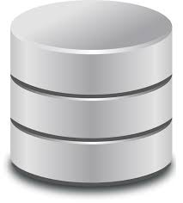
What is System Protection?
OS protection is about providing a protection system to computer system resources such as CPU, memory , disk, software programs and most importantly data/information stored in the computer system.

Slide 3

Protection is being used to deal with the internal threats.
Providing the mechanism for controlling the programs, process, user to a resource.

Slide 4
Goals of Protection
Safe sharing of a common logical address space or common physical address space.
Fair and reliable resource usage.
To protect system against unauthorized access.
Approaches such as authentication is being used.
Protection aims at detecting the potential errors related to access of resources in the system, thereby making sure that the resources of the system are protected against threats.

Slide 5

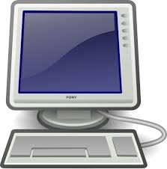
Principles of Protection
A key guiding principle plays a vital role in the design of the system.
The principle of least privilege , it dictates that the programs, users and even system be given just
enough privileges to perform their tasks.
The lesser the privilege, lesser the risk involved.

Slide 6
Example
Consider a guard of an apartment having a key. If the key has access only to the compound gate and flats in the apartment have separate keys which cannot be opened by the guard’s key, then the less privilege principle is followed and the risk associated with losing the guards key is comparatively less.

Slide 7

Implementation of the principle of the least privilege in real world computing environment is as follows
A service employee who tracks attendance of employees has access to just the employee database and commands.
Creating separate accounts for users in a shared system with privileges allocated to users based on their needs.

Slide 8


The principle of least privilege can help produce a more secure computing environment. Unfortunately, it frequently does not.
For example, Solaris, even though the varient of UNIX, is considered relatively secure than Windows 2000.

Slide 9
Domain of Protection:
A computer system is a collection of processes and objects. By objects, we mean both hardware objects (such as the CPU, printer) and software objects(such as files, programs).
Each object has a unique name that differentiates it from all other objects in the system, and each can be accessed only through well-defined and meaningful operations.

Slide 10
A process should be allowed to access only those resources for which it has authorization Furthermore, at any time, a process should be able to access only those resources that it currently requires to complete its task.

Slide 11
Domain Structures:
A process operates within a Protection Domain that specifies the resources that the process may access.
Each domain defines a set of objects and the types of operations that may be invoked on each object.
The ability to execute an operation on an object is an access right.

Slide 12
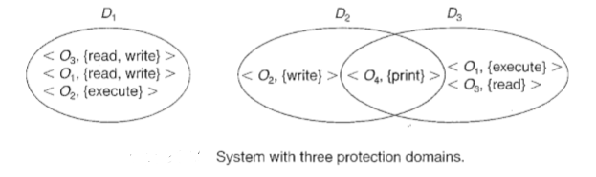
For example, if domain D has the access right <file F, {read, write}>, then a process executing in domain D can both read and write file F; it cannot, however, perform any other operation on that object.

Slide 13
A domain can be realized in a variety of ways:
Each user may be a domain. In this case, the set of objects that can be accessed depends on the identity of the user.
Each process may be a domain. In this case, the set of objects that can be accessed depends on the identity of the process.

Slide 14
Example of Unix:
In the UNIX operating system, a domain is associated with the user
In Unix operating system user ID’s use for identify the domain.

Slide 15
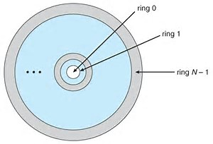
Example of MULTICS:
In the MULTICS system, the protection domains are organized into a ring structure. Each ring corresponds to a single domain .

Slide 16
THANK YOU

